Slide 1

PhishGuard: Smart Fake Website Detection
A Chrome Extension powered by Machine Learning to protect users from phishing threats in real time.
BROWSER SECURITY
MACHINE LEARNING
CHROME EXTENSION

Slide 2

The Phishing Crisis Is Growing
Fake websites are increasing at an alarming rate, designed to steal passwords, bank details, and personal data. Most users cannot distinguish a phishing site from a legitimate one — and the damage is done before they even realize it.
Rising Threats
Hidden Danger
Phishing attacks have surged globally, targeting millions of users every day.
Fake sites often look identical to real ones, making manual detection nearly impossible.
Data Theft
Credentials, financial info, and personal data are stolen silently and instantly.

Slide 3

Why Users Remain Vulnerable
The Core Problems
No manual detection: Users cannot reliably identify fake URLs or suspicious page behavior.
Lack of awareness: Most people are unaware of the signs of a phishing attempt.
No real-time protection: Basic browsers offer limited built-in safeguards against emerging threats.

Slide 4

Introducing PhishGuard
A lightweight Chrome Extension that automatically analyzes every website you visit and warns you before harm is done — using URL analysis and Machine Learning.
🔍 Automatic Detection
⚡ Instant Alerts
Shows clear warnings: Safe, Suspicious, or Dangerous.
Scans URLs in the background without any user input.
🤖 ML-Powered
Trained on real phishing datasets for high accuracy.

Slide 5
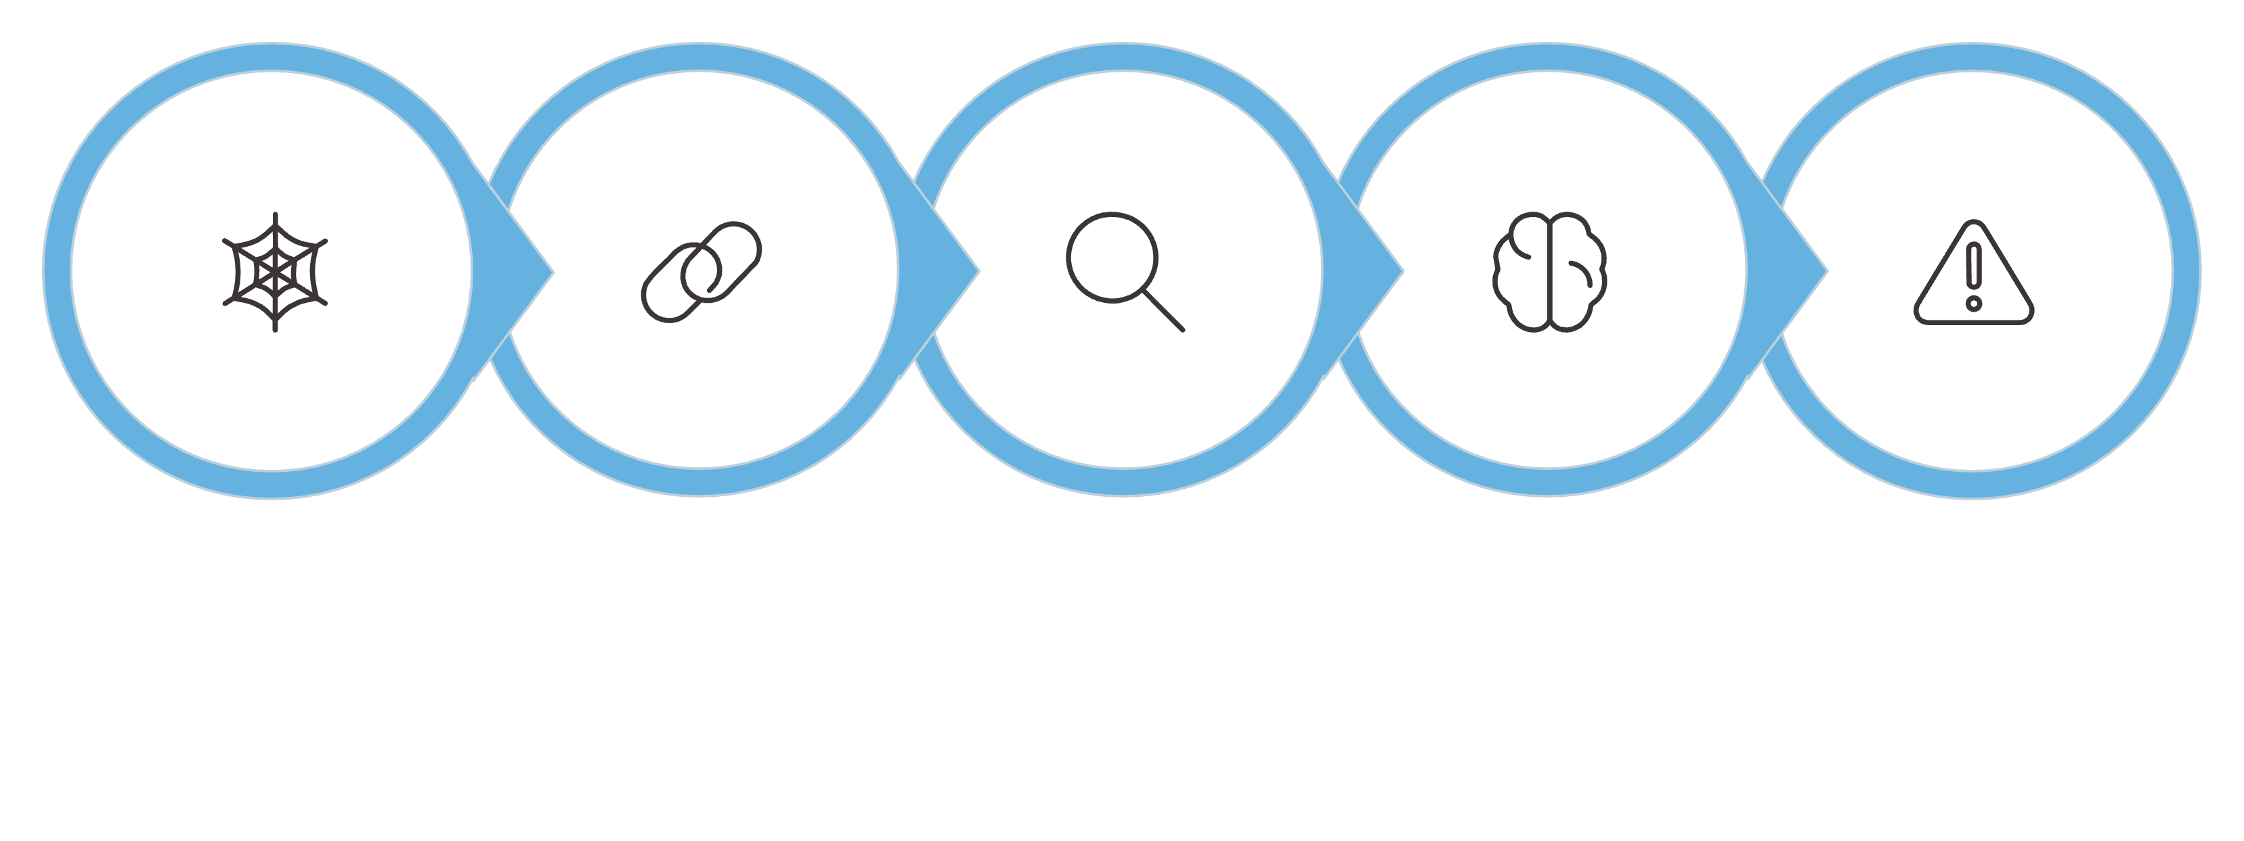
How PhishGuard Works
Visit Site
Extract URL
Analyze URL
ML Predict
Show Alert
The entire process happens in milliseconds — silently protecting you on every page you visit without slowing down your browsing experience.

Slide 6




The Technology Stack
Frontend
Chrome Extension API
Python ML Backend
Phishing Dataset
HTML, CSS & JavaScript power the extension interface and user alerts.
Python runs the ML model that classifies URLs using trained algorithms.
Trained on verified phishing datasets to ensure high detection accuracy.
Leverages Chrome's native APIs for URL interception and real-time monitoring.

Slide 7
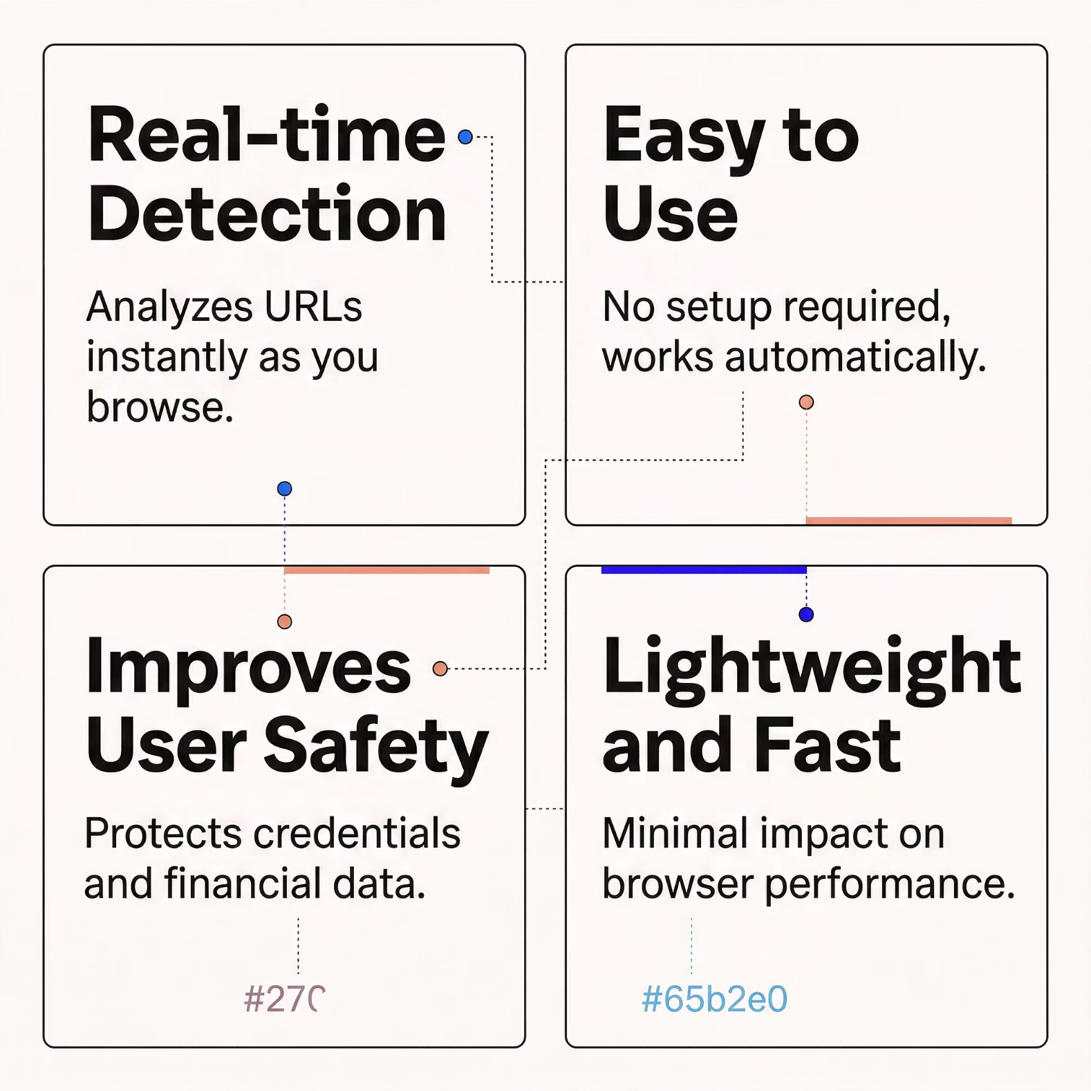


Why PhishGuard Stands Out
Built for Everyone
PhishGuard is designed to be invisible until you need it. It requires no configuration, works across all websites, and delivers clear, actionable warnings — making it suitable for both tech-savvy users and everyday browsers alike.
The extension operates entirely in the background, ensuring your browsing speed is never compromised.

Slide 8

The Road Ahead
Current Achievement
PhishGuard successfully demonstrates that a browser extension powered by ML can detect phishing websites in real time, providing an accessible layer of security for everyday users.
Future Enhancements
Improved AI models with deeper learning for higher accuracy
Support for additional browsers beyond Chrome
Community-driven threat reporting and database updates

Slide 9

Key Takeaways
Fake websites are a major, growing threat
Phishing attacks steal millions of credentials every year.
Instant detection makes all the difference
Real-time alerts stop users before they enter sensitive data.
ML makes it possible
Machine Learning enables accurate, scalable phishing detection.
A safer browsing experience for all
PhishGuard brings enterprise-grade protection to everyday users.

